Slide 1

Predicting Term Deposit Subscriptions via Telemarketing
Group 5: Aaron, Armani, Keegan, Max

Slide 2

Problem Description
Data is related with direct marketing campaigns of a Portuguese banking institution, based off phone calls with clients.
Data is meant to predict whether the client will subscribe to a term deposit with a goal of improving telemarketing methods.
A term deposit is an investment with a fixed term requiring a deposit of money to the bank.

Slide 3
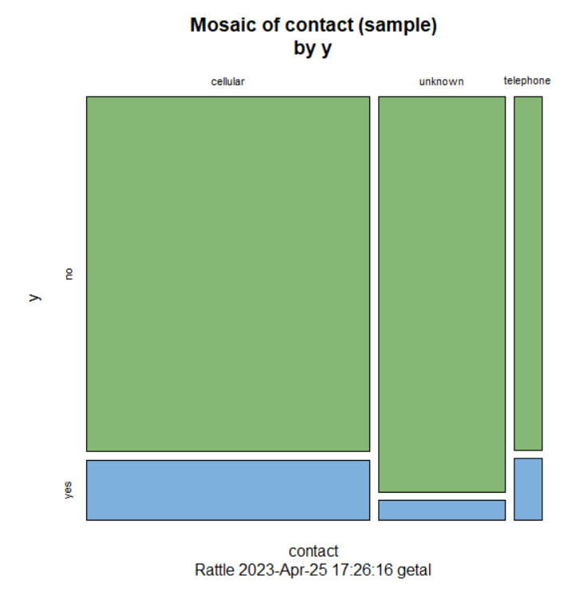
Data Description
Some variables include age, housing (loan), loan, contact, month, previous, and day.
We eliminated insignificant variables: marital, education, default, and duration.
We did not have to do any data preprocessing as the data came clean and was absent of any empty values. The models we utilized did not require any rescaling or recoding.

Slide 4
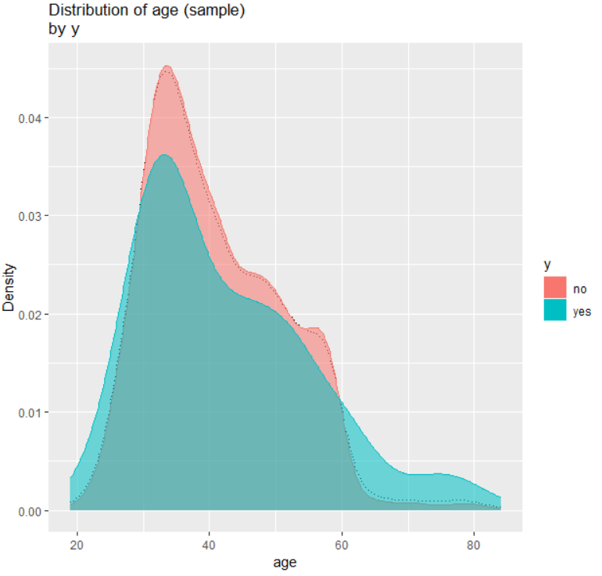
Data Description: Age

Slide 5
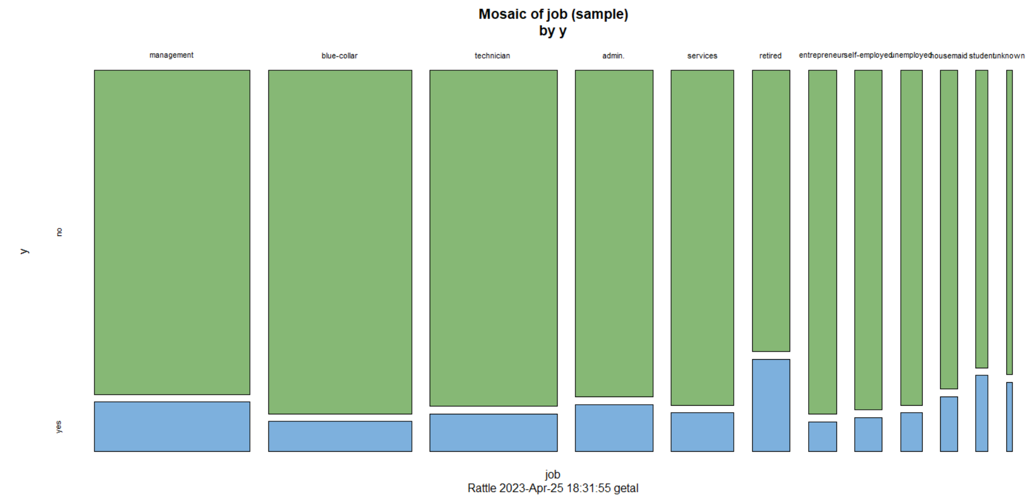
Data Description: Job Type

Slide 6
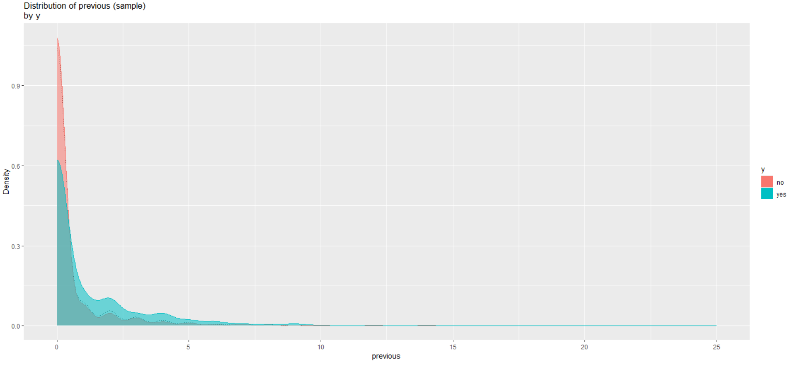
Data Description: Number of previous calls to client before campaign

Slide 7

Modeling Description
Experimented with multiple models including, Linear Regression, Adaptive boost, and Random Forest

Slide 8
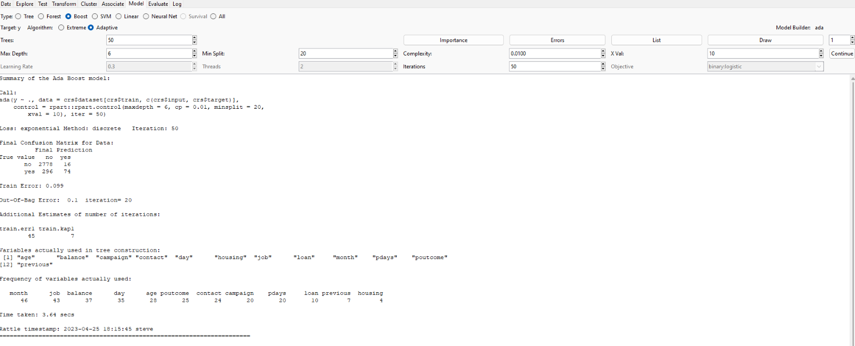
Adaptive Boost Model

Slide 9
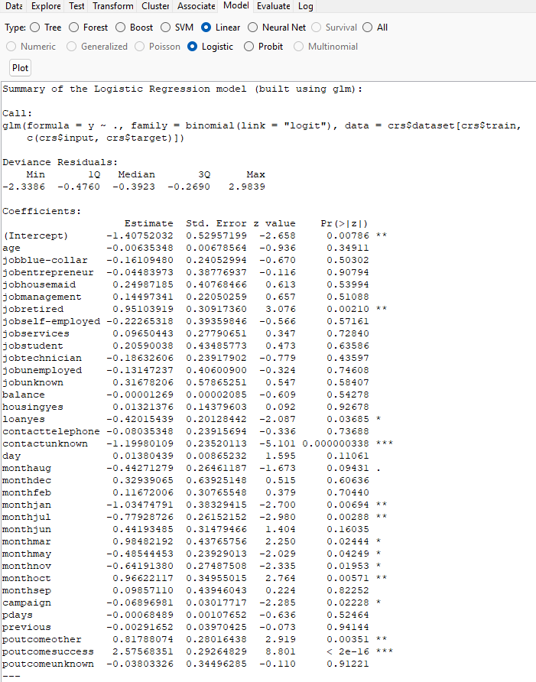
Logistic Regression Modeling

Slide 10
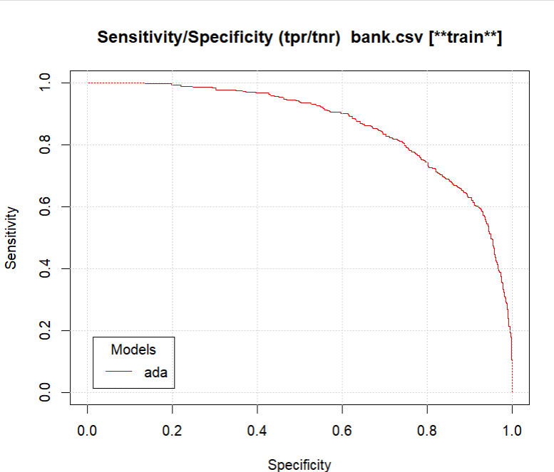
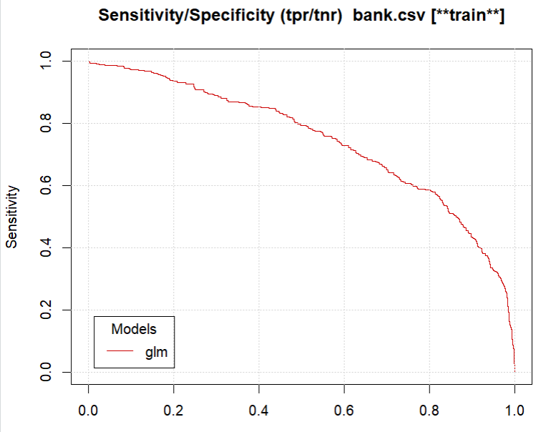
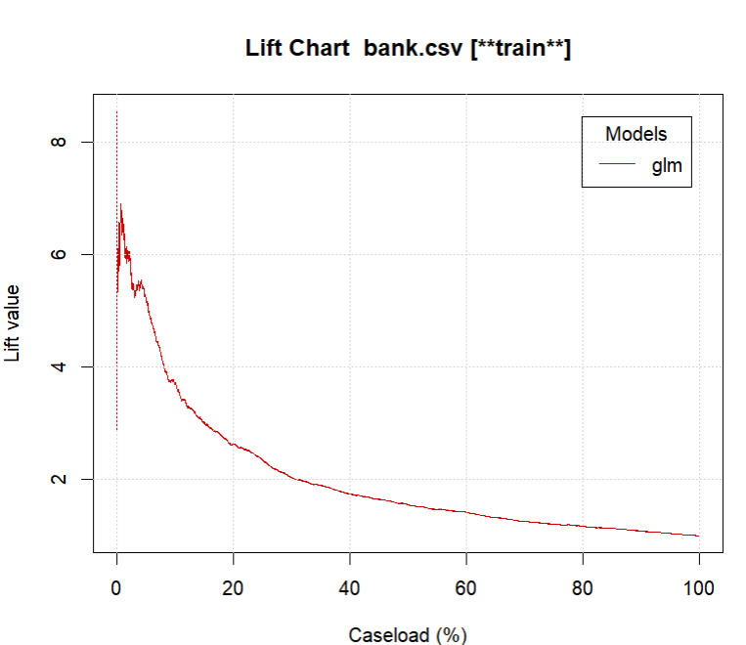
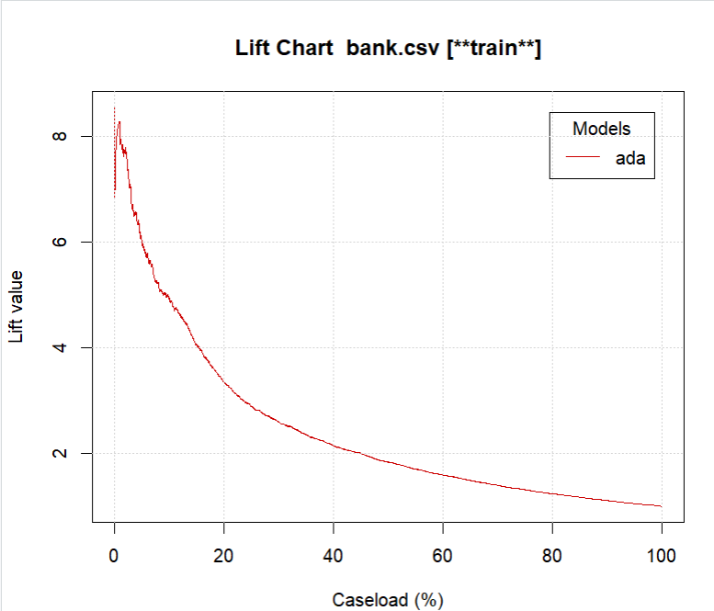
Evaluations:
This sensitivity chart shows a smoother curve than the linear regression sensitivity chart
The lift chart of the boosted model shows a slightly higher curve than the linear regression

Slide 11
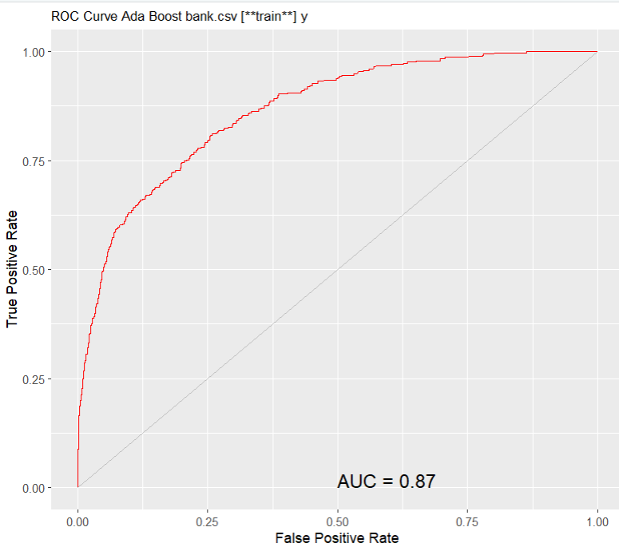
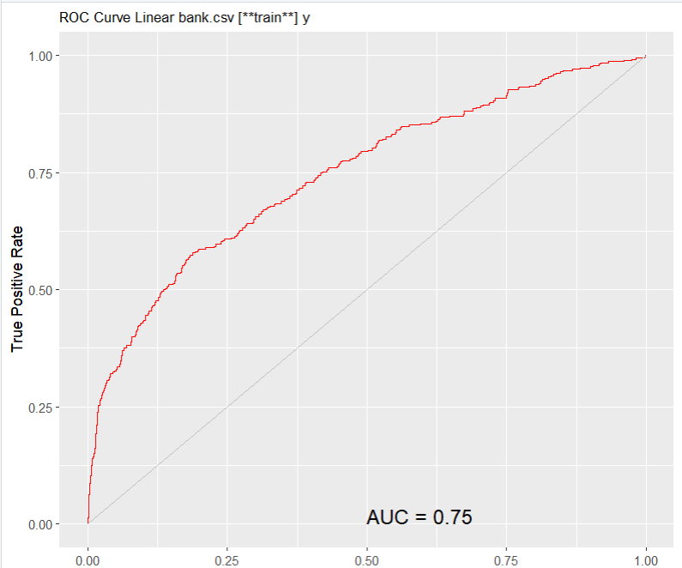
AUC Comparison:

Slide 12

Recommendations
Overall, this model suggest banks should target older, retired clients to create more subscriptions to term deposits. Those clients should also be contacted consistently, but not too often.
Moving forward, we suggest collecting more information on clients and adding more features to the model. Also, different models could be utilized.

